Slide 1

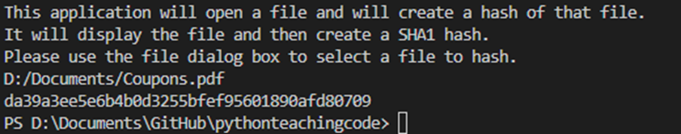
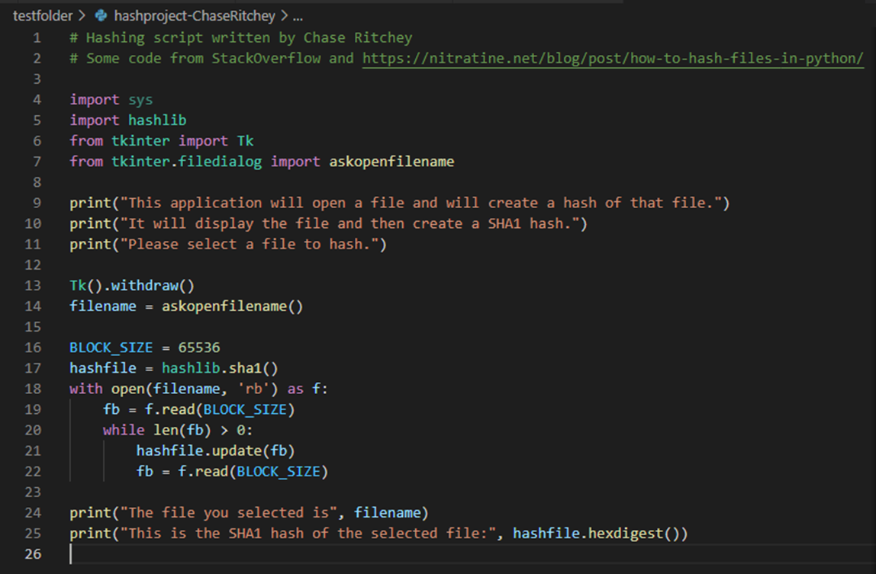
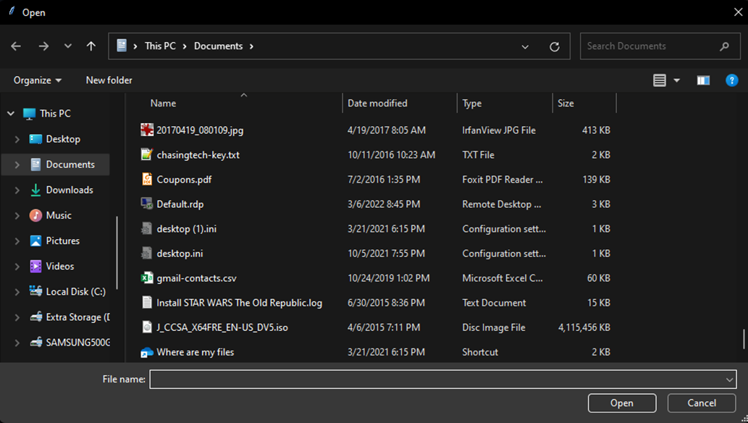
Device Hashing Script
Made by Chase Ritchey
This is a forensic tool for hashing a file. Often in computer forensics it is required to hash of a file to make sure data has not changed. The goal of this application is to do just that.

